Slide 1
Gene Report: Lamin A/C (LMNA)
By Scott Kramer

Slide 2
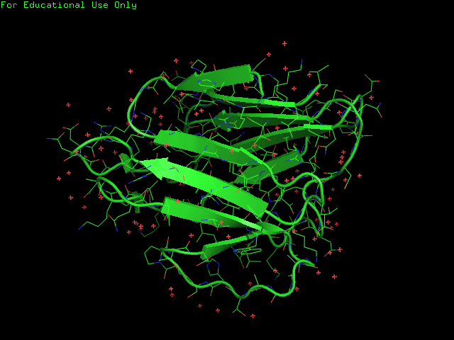
LMNA
Creates Lamin A and Lamin C proteins
Proteins provide stability to cells
Part of nuclear envelope, which regulates movement to and from the cell nucleus

Slide 3
LMNA
Part of Class V Intermerdiate Filaments protein family (“Lamins”)
Provide structure to the nuclear envelope
Found in humans
Most anmals have some form of Lamin
Conseved in chimpanzee, Rhesus monkey, dog, cow, mouse, rat, zebrafish, mosquito, and frog.
146 organisms have orthologs with human LMNA

Slide 4
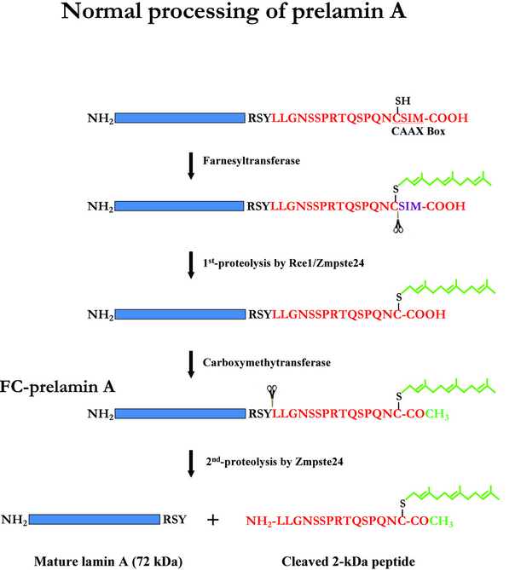
Lamin A
Involves series of steps before it can be inserted into Lamina¹
Farnsyl group attaches to protein
Protelysis enzyme breaks off amino acids
Carboxymethytransferase enzyme catalyzes the addition of a methyl group
Another protelysis enzyme breaks off the mature lamin A

Slide 5
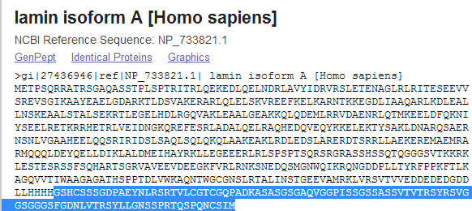
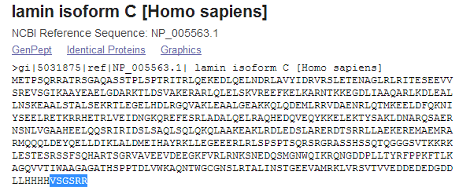
Lamin C
Considered an isoform of Lamin A
Isoforms are extremely similar proteins, often produced from same gene
Unlike Lamin A, it can be inserted directly into the lamina

Slide 6
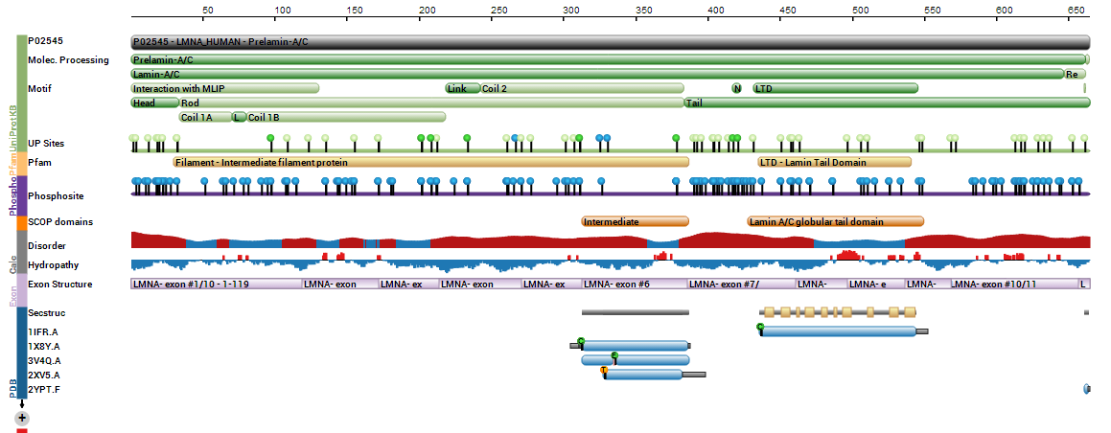
LMNA
Globular Tail Domain
Involved in binding Lamin A to the nuclear envelope
Intermediate coiled region
C-terminal domain (carboxyl group at end of amino acid chain)

Slide 7
Mutations
Mutations often damage nuclear envelope
Can cause multiple diseases
examples: Charcot-Marie Tooth disiease, Emery-Dreifuss muscular sytrophy, Hutchinson-Gilform Progeria syndrome

Slide 8
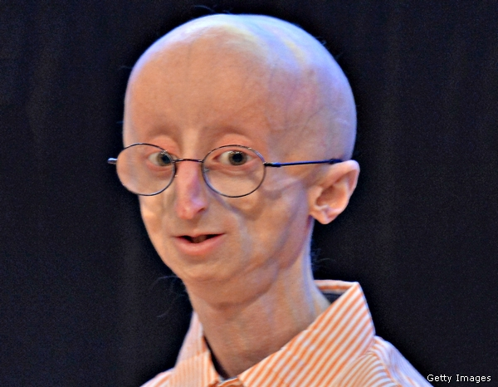
Progeria
Causes humans to age rapidly
Most don’t live past teenage years
Occurs in 1 in 8 million people
No known cure
Might clue us in how aging works

Slide 9
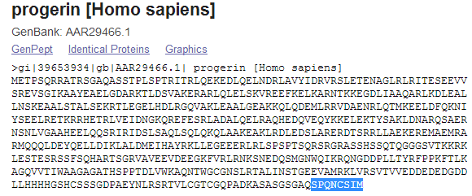
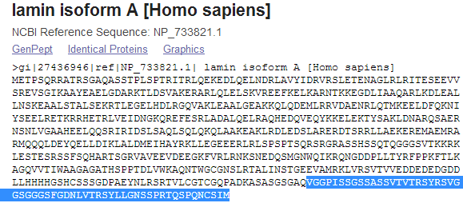
Progeria
Occurs when cytosine is replaced with thymine at position 1824 in gene
Causes an altered version of Lamin A called Progerin , which is missing 50 amino acids near one end
Progerin damages the structure of the nucleus
Normal humans have small amounts

Slide 10
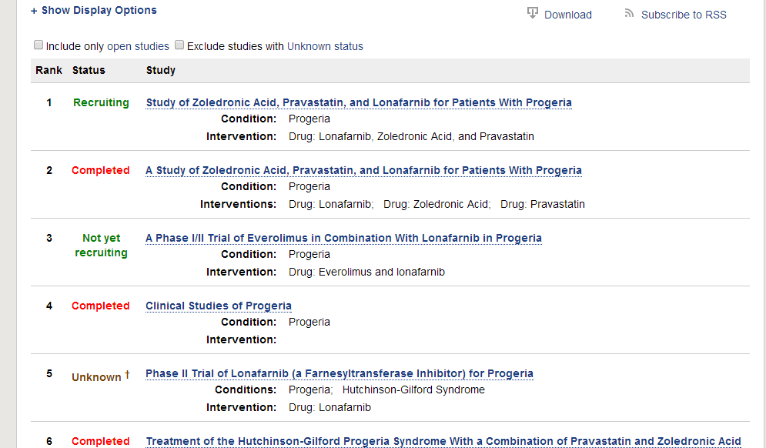
LMNA Research
Lots of ongoing research on Progeria

Slide 11
LMNA Research
Developing mouse model of Progeria
Blastp search shows mice have highly similar protein
E value of 0.0
Identity percentage of 97%

Slide 12
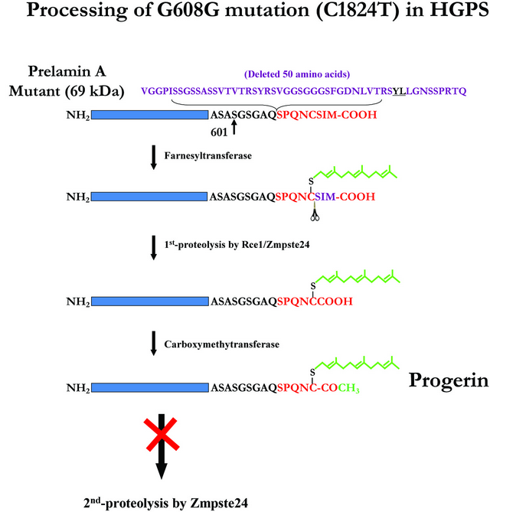
LMNA Research
May 2014 - Discovered first drug (Lonafarnib) to increase lifespan in children with Progeria²
Mean survival extension for trial participants was 1.6 years
farnesyltransferase inhibitor (FTI)
Toxic effect of Progerin is caused by farnesyl group that attaches to it and harms cells
FTIs block the attachment of the farnesyl group onto progerin

Slide 13
References
http://www.impactaging.com/papers/v1/n1/full/100012.html
http://www.ncbi.nlm.nih.gov/pubmed/24795390

Slide 14
LMNA Research - Next Steps
Determine method to produce normal Lamin A
Remove Progerin that has already attached to farnysel group

Slide 15
THE END
(for computer scientists)

